Slide 1
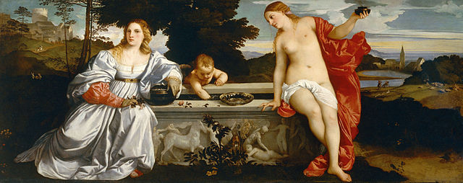
History 336
Ideas and Society in Early Modern Europe:
The Debate about Gender and Identity

Slide 2
Basic question
How does gender serve as a useful category for historical analysis in a study of the witch hunt in early modern Europe?

Slide 3
Questions
What are maleficia (singular: maleficium)? Give some examples.
Witch beliefs have long been part of European culture. What was so distinctive about them in the early modern period that they fueled witch hunts?
What factors might explain the witch hunts in early modern Europe? Are they all equally convincing?
Where did witch hunts seldom occur and where did they occur in great numbers? Why? In which countries did witch hunts cease the earliest? Where did they persist?
Why was witchcraft commonly associated with women?
How did witch hunts begin? What procedures were used at witch trials to determine guilt? How did small hunts develop into large-scale panics?
What is the significance of the illustration on p. 261?

